Slide 1

C L O U D - E N H A N C E D D I S A S T E R R E S P O N S E A N D R E C O V E R Y S O L U T I O N S
TEAM 13: RISHI TEJA RAPARTHY SAI SRI HARIKA KOUNDINYA VAJHA SRILEKHA NAMPELLI
This Photo by Unknown author is licensed under CC BY-NC-ND.

Slide 2

CONTENTS
INTRODUCTION
DATASET DESCRIPTION
MODEL ARCHITECTURE
MODEL IMPROVEMENT
RESULTS
USER INTERFACE
USE OF CLOUD
CONCLUSION

Slide 3
INTRODUCTION
WHAT?
WHY?
HOW?

Slide 4
WHAT IS THE PROBLEM?
Prediction of Natural Disasters
Minimization of Response Times
Cloud-Enhanced Solutions

Slide 5
WHY WE CHOOSE THIS PROBLEM?
Encountered the unpredictability and impacts of natural disasters
Aim to tackle this challenge using our resources.

Slide 6
HOW DID WE SOLVE IT?
Gathering Real Data
Cloud Infrastructure
Smart Predictions using Machine Learning models

Slide 7
DATASET DESCRIPTION
Created subset of dataset using information from : National Centers for Environmental Information and Global Wildfire Information System
The dataset has:
EventType,Location,DateTime,Magnitude,Casualties,Evacuation,PropertyDamage,Duration,ResponseTime,WarningsIssued,Source

Slide 8
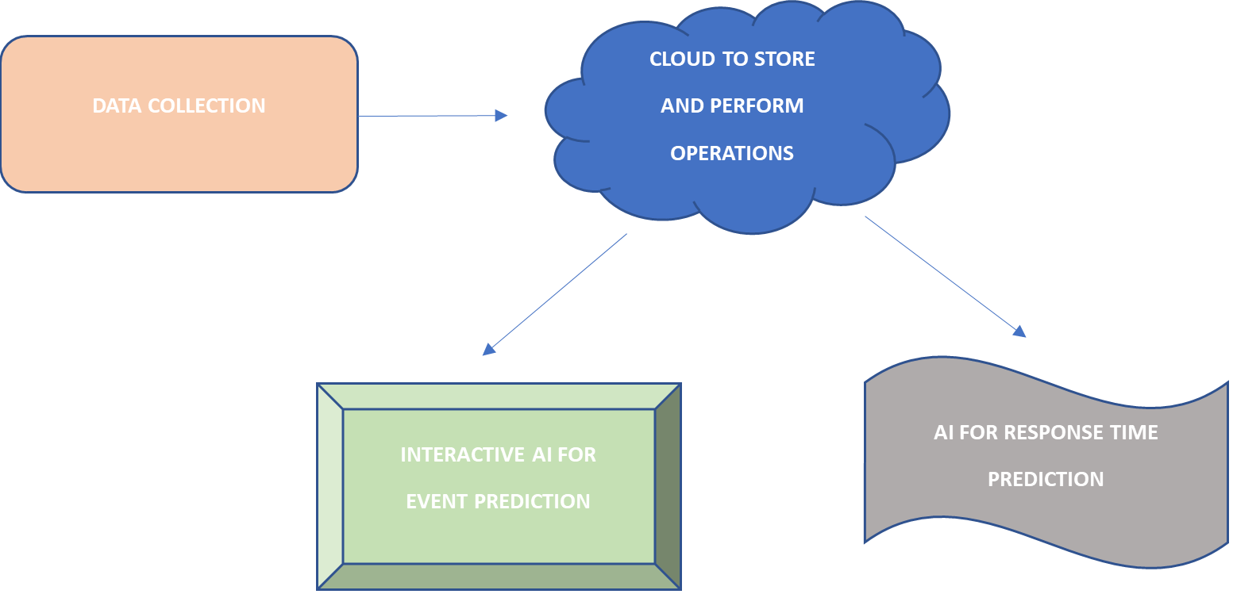
MODEL ARCHITECTURE

Slide 9
MODEL DESCRIPTION
Used PySpark for efficient distributed data processing with Apache Spark
01
Created Separate models for Event prediction & Response Time Prediction
02
Evaluated Accuracy and Root-mean square error
03

Slide 10
MODEL IMPROVEMENT
Cross-Validation
Hyperparameter Tuning
Feature Engineering

Slide 11
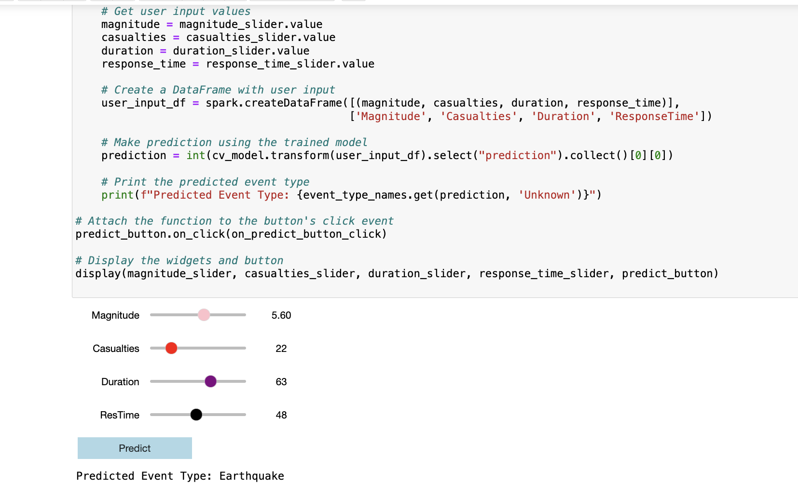
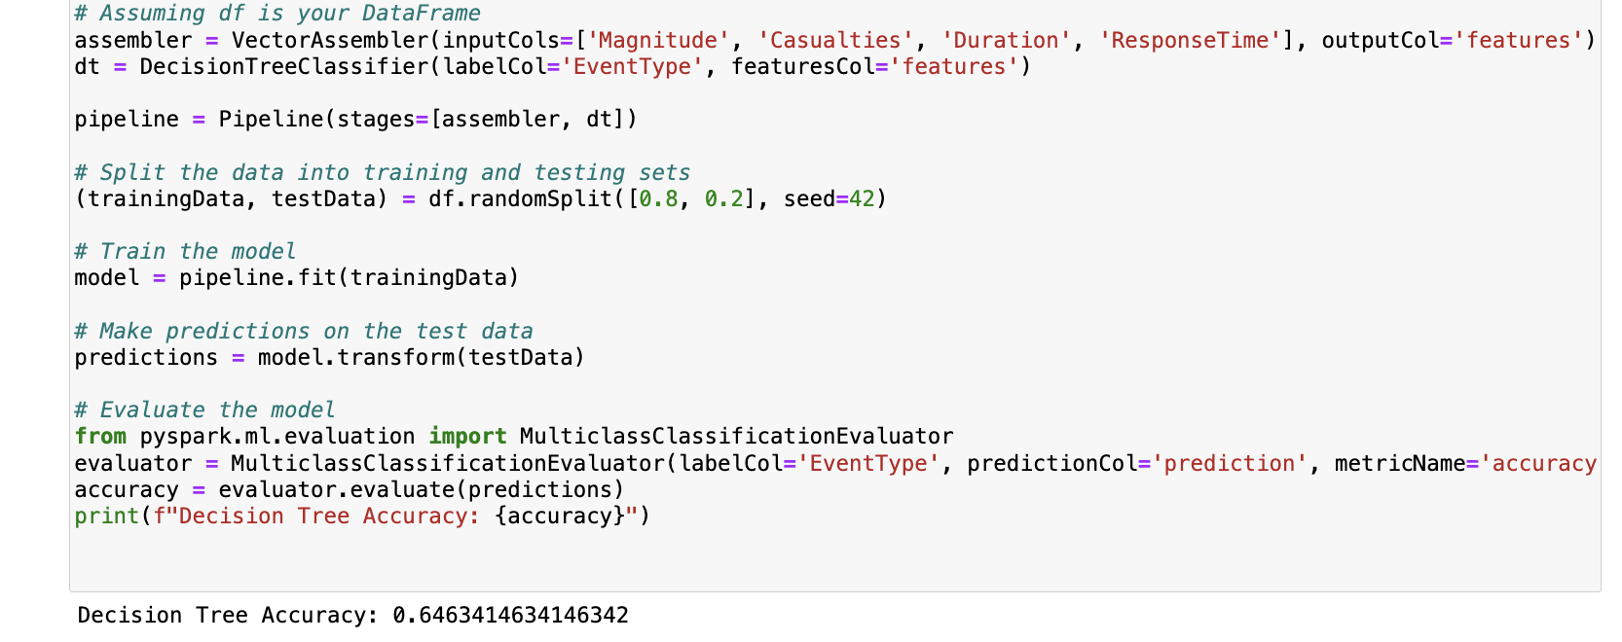
CODE SNIPPETS

Slide 12
RESULTS
PREDICTION | MODELS USED | IMPROVEMENTS
EVENT PREDICTION | DECISION TREE: 64.64 RANDOM FOREST: 67.45 LOGISTIC REGRESSION: 45.90 | RANDOM FOREST WITH CROSS VALIDATION: 76.32
RESPONSE TIME PREDICTION | DECISION TREE REGRESSOR: RMSE:7.45 RANDOM FOREST REGRESSOR: 5.32 | TUNED RANDOM FOREST: 4.72

Slide 13
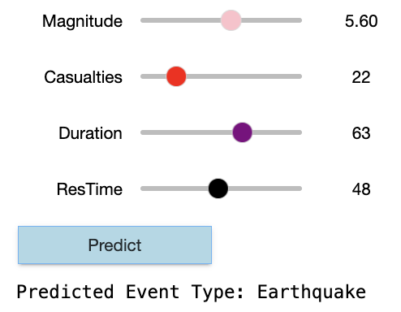
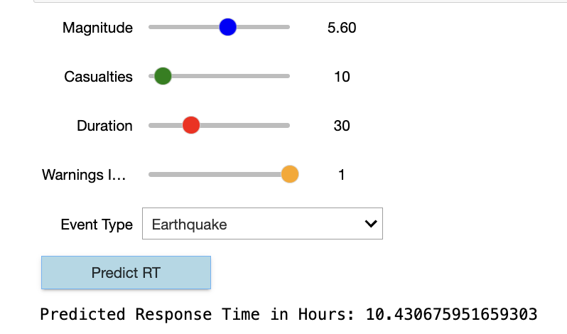
USER INTERFACE

Slide 14
USE OF CLOUD
Scalability
Distributed Computing
Accessibility and Collaboration

Slide 15
CONCLUSION
Implemented models to predict response times.
Future directions includes: Real-time Data Integration, Geospatial Analytics and Visualization

Slide 16

THANK YOU

